Slide 1
Shine Bright Like a Diamond: How Diamond Retailers Sparkle When They Mobilize Content Marketing
BitterRoot Content

Slide 2
You don’t just sell diamonds, you turn dreams into reality
Able to see and coax beauty out of unassuming rocks, jewelers today are so much more than the big-store, cookie cutter, diamond retailers of yesteryear. And the outlook looks as bright as a colorless diamond.
The engagement ring market is projected to grow to $40 million by 2027. That's a compound annual growth rate of 4.31%.*
But more opportunity equals more challenges. Today, many engagement ring businesses are finding themselves faced with a variety of threats including:
Increasing competition leading to an oversaturated market
The continual rise of online shopping, rendering in-person sales mute
Continual digital stimulation resulting in decreased attention spans and poor brand recognition by consumers
*Verified Market Research, Dec. 2021

Slide 3
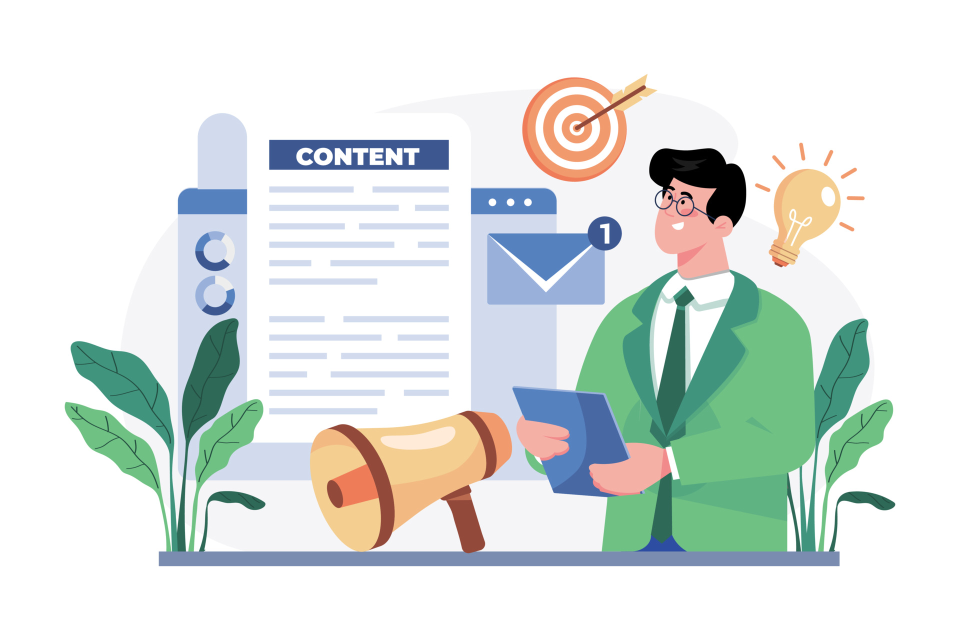
Content marketing can help
In a world where consumers are constantly bombarded with advertisements and promotional messages, content marketing cuts through the clutter to deliver valuable, relevant, and engaging content that is simply a cut above the rest.
In 2022:
409 million people view more that 20 billion blog posts per month
Websites with blogs have 434% more indexed pages
67% of marketers report that content marketing helps generate leads
70% of people would prefer to get information from blogs rather than advertisements
Source: Ahrefs, Oct.2022

Slide 4
Selling diamonds online has a Mohs rating of 10.0
Content marketing is a long-term digital marketing strategy that creates and shares highly relevant, valuable, and engaging digital content to drive customer profitability, increase brand awareness and authority, and connect more deeply with customers.
Brands that employ a content marketing strategy see 3x the amount of leads at 62% *less cost than traditional marketing.
Additionally, brands receive 1000%* more organic traffic when they utilize content marketing over organic social media.
Content marketing helps soften the scale
*OptinMonster, 2023

Slide 5
Like diamond cuts, content marketing comes in many different shapes
Content marketing can include:
Blog posts including long-form, short-form, listicles, and reviews
Videos
Newsletters and email-marketing
Branded podcasts
And, more!
The goal of any created content is to provide valuable advice while not directly selling to the consumer, ultimately positioning your brand as a leader in your industry. This build trust, increases brand awareness, and drives sales.

Slide 6
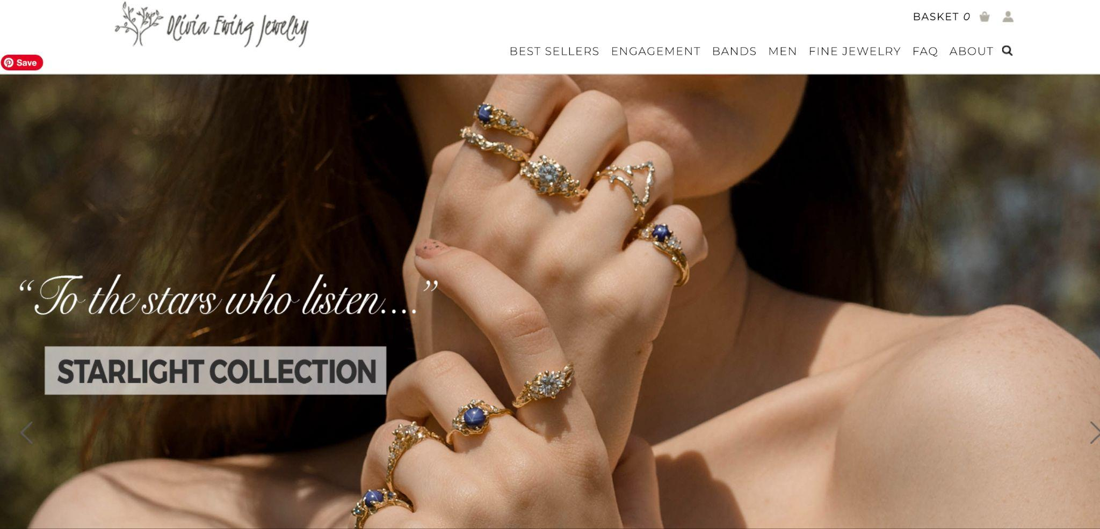
Case Study: Olivia Ewing Jewelry
Client and Problem:
Olivia Ewing Jewelry, an online retailer and creator of stunning nature-inspired engagement rings, made the decision to move from selling their rings on Etsy to their own channel. In doing so they found themselves faced with the challenge of driving organic traffic to their site that would establish industry authority and generate sales without Etsy's name recognition.

Slide 7
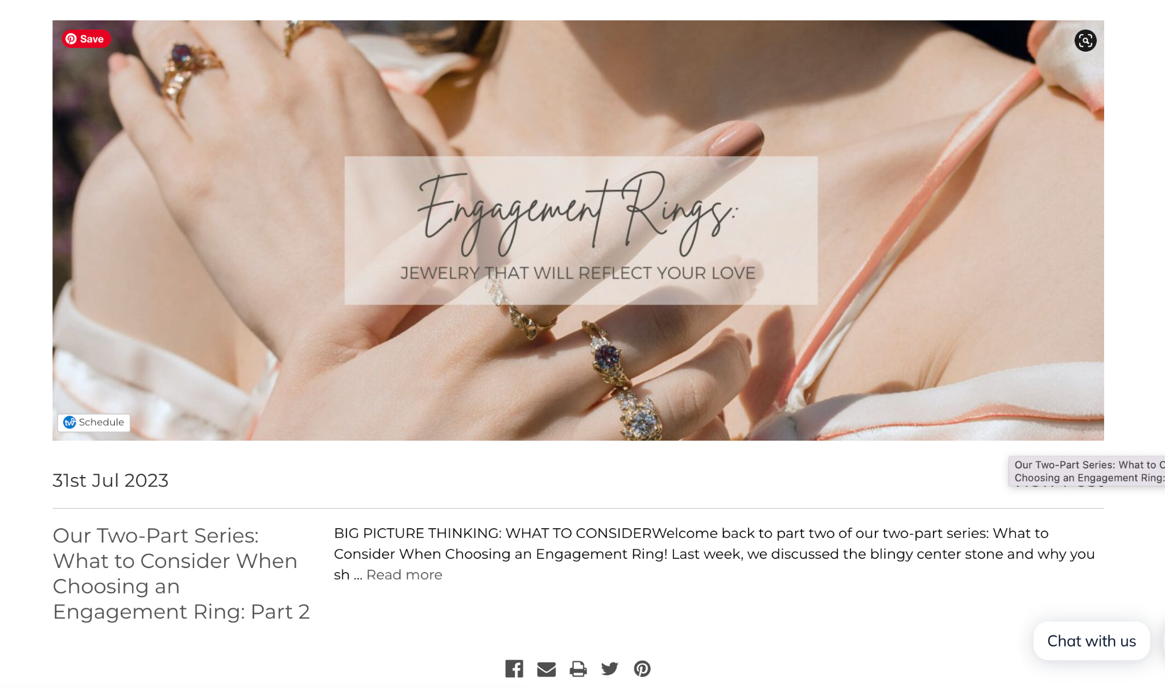
Case Study: Olivia Ewing Jewelry
Solution:
The BitterRoot Content team worked with Olivia Ewing Jewelry to analyze and update their current content marketing strategy.
Utilizing cutting-edge programs that shed light into competitive keywords and areas that could be improved, they worked to create four blog posts a month that positioned the brand as a leading authority of engagement rings while appealing to their specific targeted-audience.
Search engine optimization was utilized to improve the search engine results page ranking and quarterly meetings were held to ensure of the content with the brand.

Slide 8
Case Study: Olivia Ewing Jewelry
Results
In one year:
357% increase in organic traffic
22% increase in revenue
21% increase in customers
5 point increase in domain authority

Slide 9
Let’s turn your business dreams into reality
Interested in mining the power of content marketing? BitterRoot Content can help.
We develop custom SEO content marketing strategies and full-service content creation and management so you can drive quality organic traffic to your website that will increase conversions, brand authority, and brand recognition.
Contact molly@bitterrootcontent.com today to learn how you can receive a complimentary content audit to develop a better understanding of how you can supercharge your sales with content marketing.

